Slide 1
Templates
They make life better

Slide 2
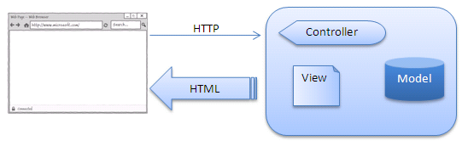
What a template engine is
<html>
….
Hello {{name}}
….
</html>
BladeOne
HTML
// inspect GET and POST and COOKIE
// grab data from Database:
$user_name = “John”;
$blade->run("hello", array(“name"=>$user_name));

Slide 3
What it does for you
With PHP you will end up with:
PHP
HTML
PHP
HTML
This is a mess. Changing the HTML can break the HTML – we are mixing view and control into one file – bad!

Slide 4
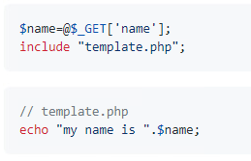


This is a security risk – if someone enters some JS as the name, your site will break
Easy to miss or forget
Blade does this automatically – hard to get wrong

Slide 5
Laravel – the template engine
There are lots of template engines
Blade is part of Laravel – the most popular PHP framework
Learning a framework is beyond the scope of the T-Level
But we will use some of the ideas and tools it provides

Slide 6
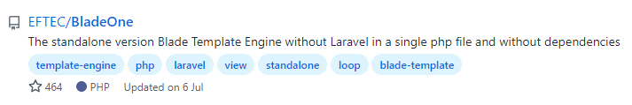

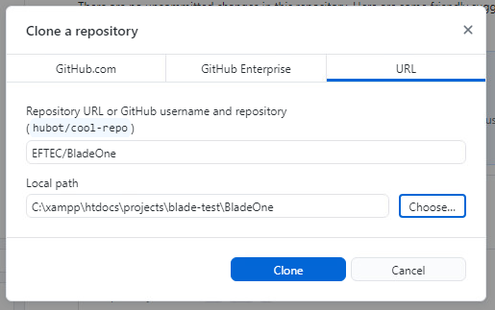

Slide 7
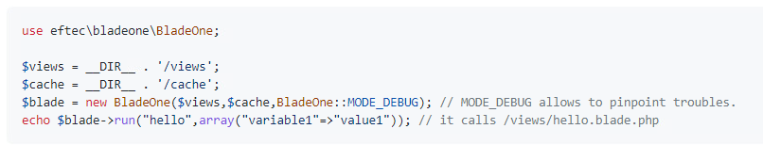
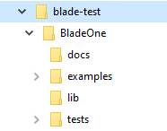
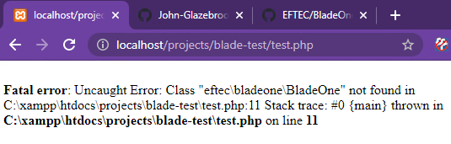
The documentation does NOT match our project:
Namespace – see later slides
We have no class autoloader, so PHP doesn’t know where the class file is

Slide 8
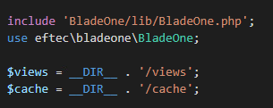
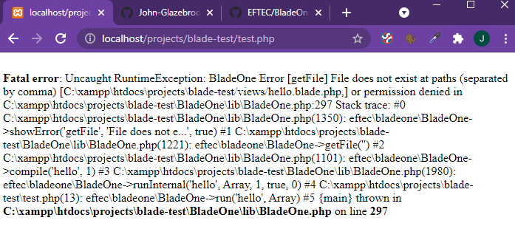
Tell PHP to pull the Blade code in.
/views
/cache
Don’t exist. But BladeOne is running and reporting the error, so the include path is working

Slide 9
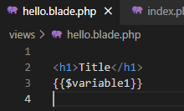
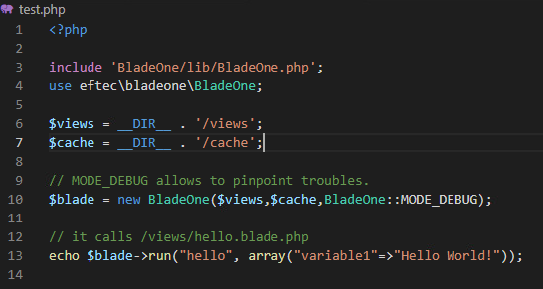
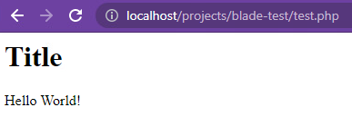
/views/hello.blade.php

Slide 10
Template inheritance
Why templates are nice – reduce the amount of front end code
Reduce duplication
Help designers who hate code

Slide 11
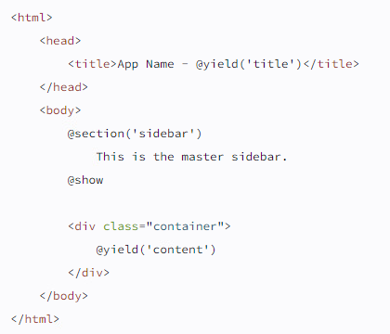
resources/views/layouts/app.blade.php

Slide 12
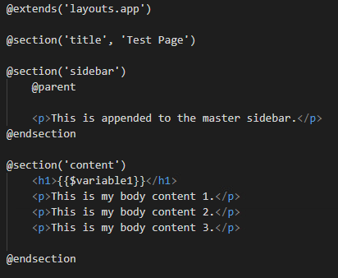
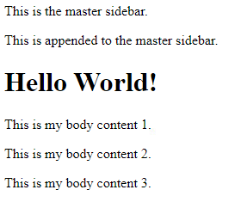


Slide 13
tasks
https://laravel.com/docs/8.x/blade#layouts-using-template-inheritance
Create a website
With 5 pages
Each sharing a common template
Navigation bar (page 1, page 2, page 3, page 4, page 5)
Ensure the nav shows the page the user is on

